Slide 1
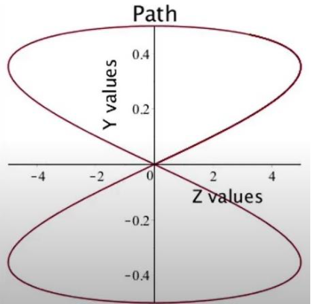
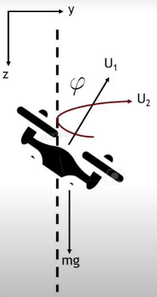

UAV Trajectory Controller
INTRODUCTION
As drones are growing rapidly in popularity, their use in multiple section is increasing exponentially. Over the past few years, drones have become central to the functions of various businesses and governmental organizations and have managed to pierce through areas where certain industries were either stagnant or lagging behind.
SYSTEM OVERVIEW
We have designed a flight controller for a 2d quadcopter in Simulink. We have modelled it in two dimensions, ZY plane and drone will be moving only in that plane. Cascade controller is designed for this task because the number of control variables are less than degree of freedom.
For our path we will be using a figure 8 the drone will be starting at (0,0) and moving in a figure 8 and coming back to (0,0).
CONTROL DESIGN
There are 3 feedback loops in the controller. In the first feedback loop we use the error (difference between Z input and Z output) The Φ is the inner loop and Y is the outer loop, so there are two error feedback loops. Since it is a PD CONTROLLER, the KI value in all the PID BLOCKS are set to zero.
PROJECT BY :
Sanket Sharma | Ajit Singh | Ankit Chaudhary | Omm Jagga | Kartikay Chiranjeev Gupta

Slide 2
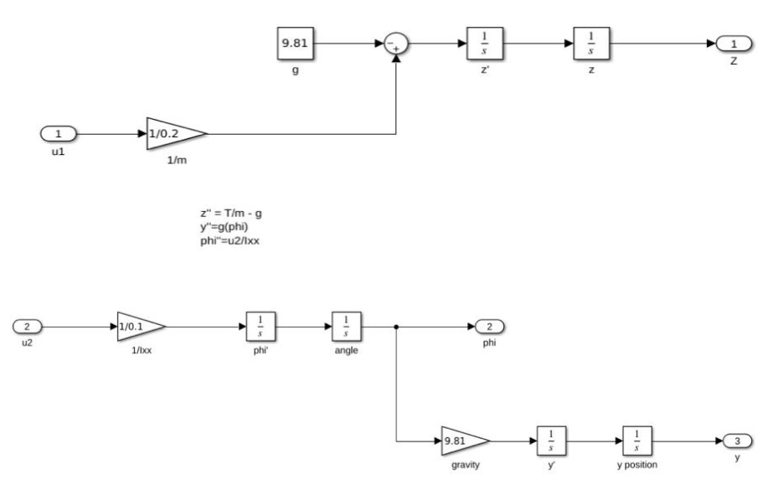
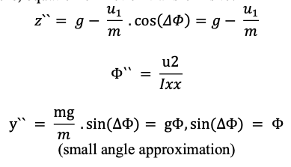
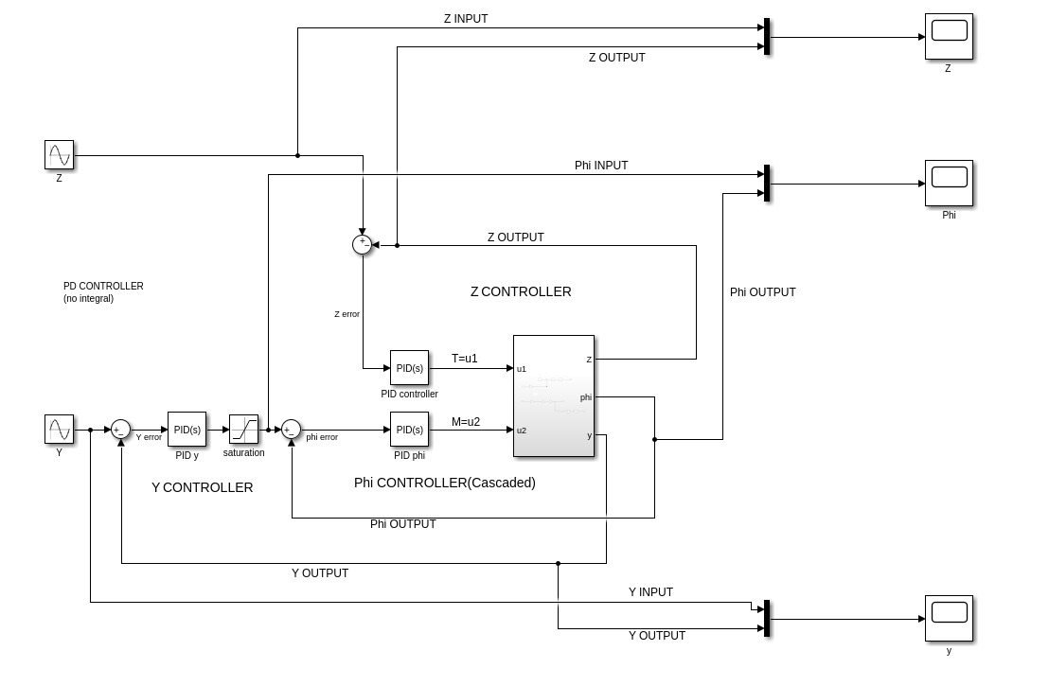
PLANT MODEL
Our system combine two approaches, plant and feedback model, to design trajectory and control model of a quadrotor UAV. This combined approach will help the model design to be much efficient.
In our plant model approach, mathematical model for dynamics of drone with respect to Z and Y plane are constructed.
FEEDBACK SYSTEM
The open-loop configuration is not efficient to change the thrust, moment and roll angle of the quadrotor depending upon the error between desired co-ordinate and actual rotor position. Hence a PID feedback system is employed in quadrotor control system

Slide 3
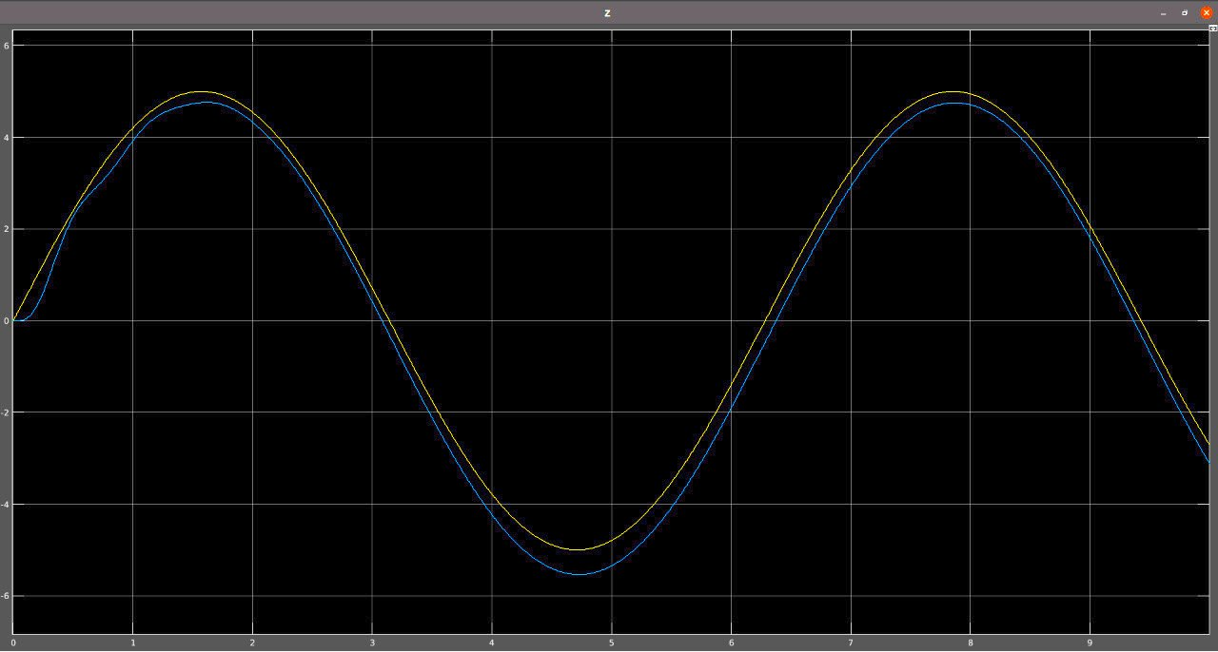
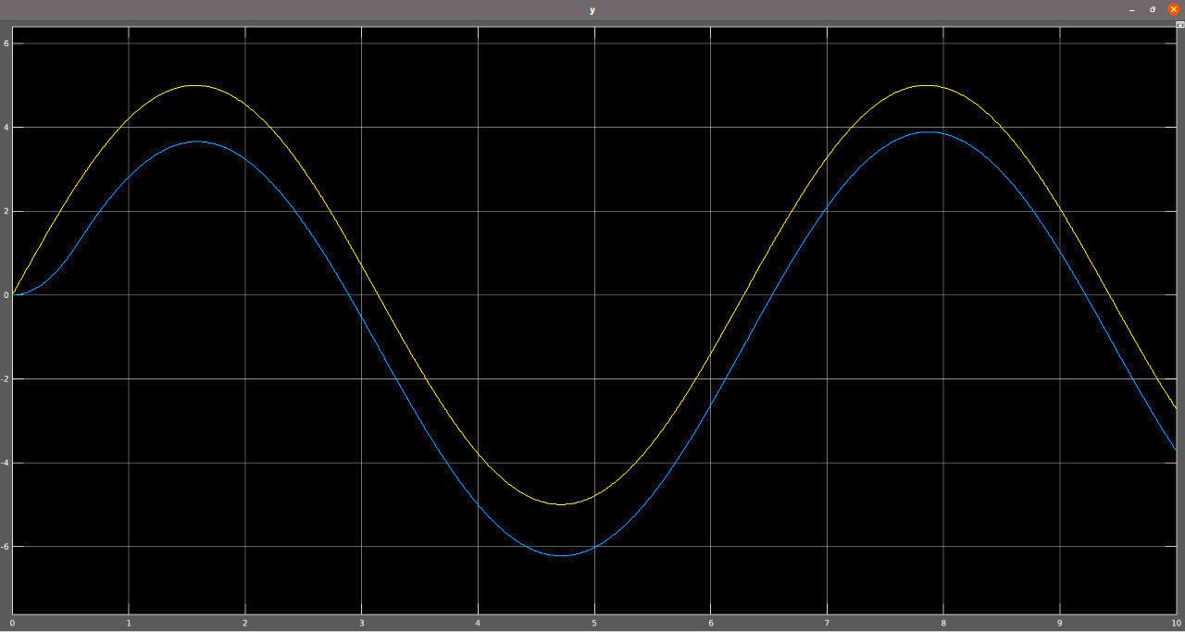
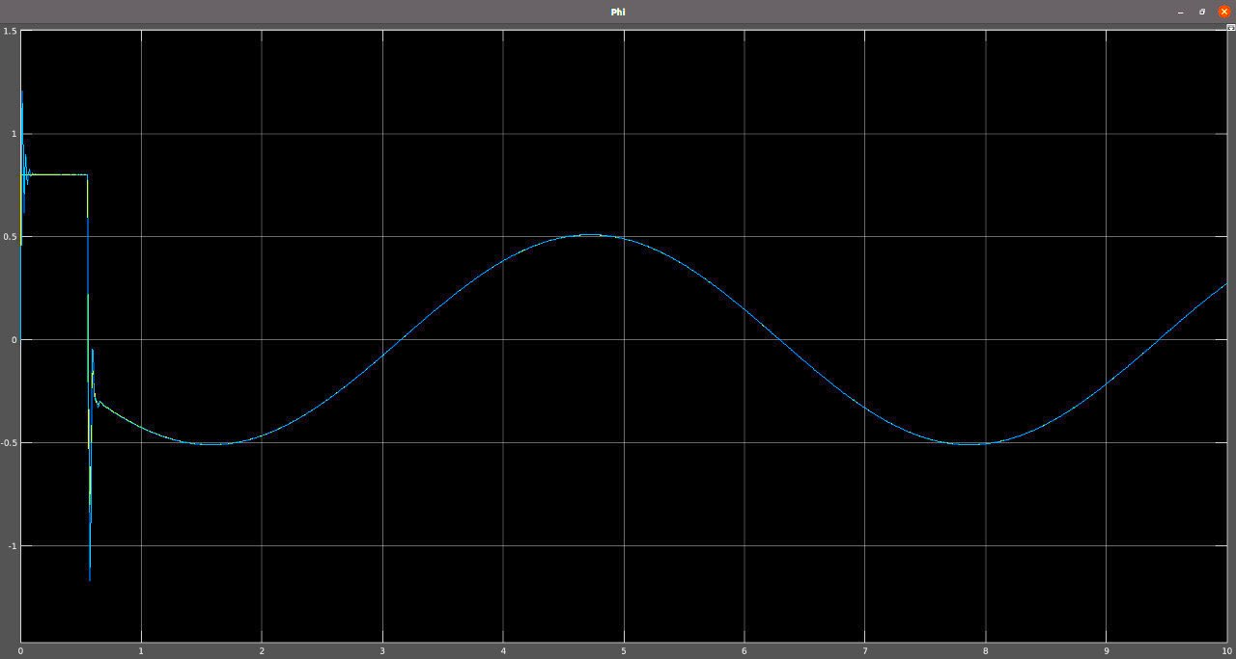
Result 1. Input trajectory vs Output from plant for Z plane
Result 2. Input trajectory vs Output from plant for Y plane
Result 3. Input roll angle vs Output angle from plant

